Slide 1
Chapter One
Marketing: Creating and Capturing Customer Value

Slide 2
What is Market?
Market is the place where sellers & buyers meet. (Simplest definition)
It can be said that a market is the place where prices of goods and services are established. (Little more complex)
A market is one of many varieties of systems, institutions, procedures, social relations and infrastructures whereby parties engage in exchange. (Very complex definition)

Slide 3
Buzz Words
Markets are the set of actual and potential buyers of a product

Slide 4
What is Marketing?
Three Mistaken Views
Marketing is Selling
No, because:
Selling is part of Marketing
Marketing starts long before the company has a product or service
Marketing involves homework to asses needs, measure their extent, and determine if a profitable opportunity exists
Selling only occurs only after a product is manufactured or a service is created
Marketing continues throughout a product’s life, finding new customers, improving product appeal and performance, and managing repeat sales
Philip Kotler “On Marketing”

Slide 5
What is Marketing?
Three Mistaken Views
Marketing is Advertising
No, because:
Advertising is part of Marketing
Marketing starts long before the company places and ad or develops an advertising strategy
Advertising becomes part of an over-all Marketing Plan
Advertising only occurs only after a product is manufactured or a service is created
John Eichenberger “Personal Experience”

Slide 6
What is Marketing?
Three Mistaken Views
Marketing is Mainly a Department
No, because:
Yes, companies do have Marketing Departments, but,
All departments should be at least customer oriented if not customer driven
In highly competitive markets, all departments must focus on winning customer preference
“Companies can’t give job security. Only customers can” – Jack Welch, General Electric CEO
Phillip Kotler “On Marketing”

Slide 7
What Is Marketing?
Marketing is a process by which companies create value for customers and build strong customer relationships to capture value from customers in return

Slide 8
Another Definition Could be
Marketing involves having the right product available in the right place at the right time and having right price making sure that the customer is aware about the product.

Slide 9

Marketing Mix
The “Four P’s”
P
roduct
P
ricing
P
lace
P
(Distribution)
romotion
1-<number>

Slide 10
Understanding the Marketplace and Customer Needs
Core Concepts
Customer needs, wants, and demands
Market offerings
Value and satisfaction
Exchanges and relationships

Slide 11
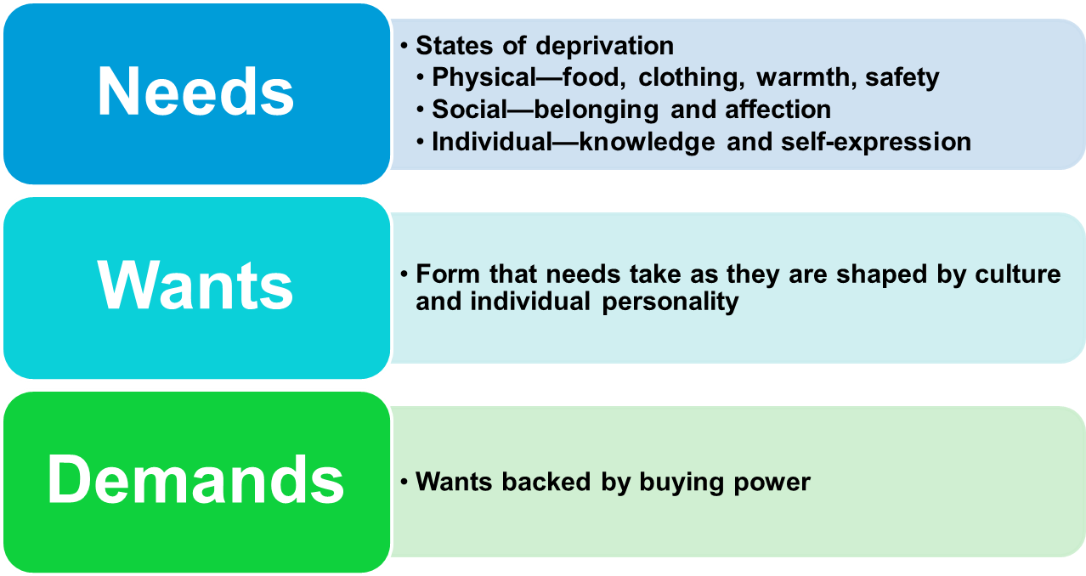
Understanding the Marketplace and Customer Needs
Customer Needs, Wants, and Demands

Slide 12
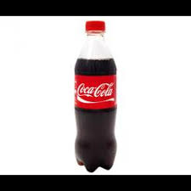
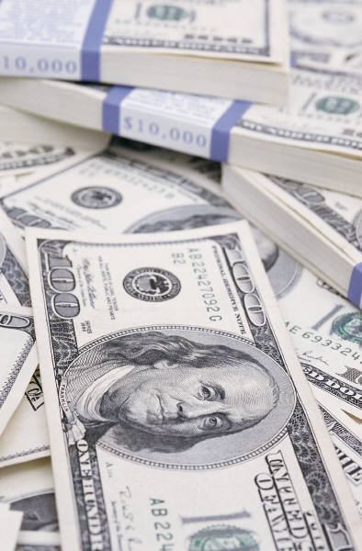
This is Demand
Want
Buying Power
“Demand”
1-<number>

Slide 13
Understanding the Marketplace and Customer Needs
Market offerings
Are some combination of products, services, information, or experiences offered to a market to satisfy a need or want
Marketing Myopia:
A disease in which marketer focus too much on existing product and loose sight of underlying customers need.
      Palm Royale.
      ABC accountants.
      Software houses should least concerned with the commission structures.

Slide 14

Segmentation and Target Marketing
#1
#2
Market Segmentation:
Divide the market into segments of customers
Target Marketing:
Select the segment to develop
1-<number>

Slide 15
Designing a Customer-Driven Marketing Strategy
Selecting Customers to Serve
Demarketing is marketing to reduce demand temporarily or permanently; the aim is not to destroy demand but to reduce or shift it

Slide 16
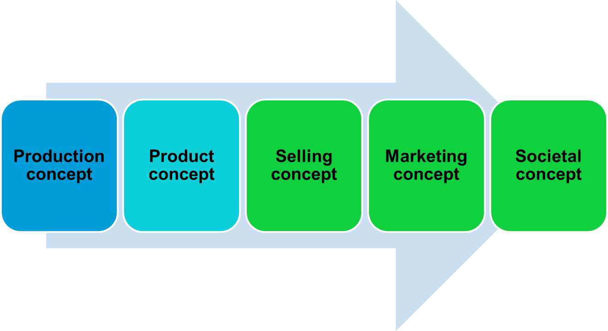
Designing a Customer-Driven Marketing Strategy
Marketing Management Orientations

Slide 17
Marketing Management
Philosophies(1)
Production Concept
Consumers favor products that are available
and highly affordable
Improve production and distribution cost
Run a risk of focusing too narrowly on their
own operation
e.g lenovo computers

Slide 18
Marketing Management
Philosophies(2)
Product Concept
Increasing competition
Consumers favor products that offer
the most quality, performance,
and innovative features
Continuous product improvement
lead to Marketing Myopia
e.g mosquito mats , Nokia

Slide 19
Marketing Management
Philosophies(3)
Selling Concept
Consumers will not buy enough of the
organization’s products unless the organization
undertake a large-scale promotion/selling
Track down prospects and selling them on
product benefits
Sell what they make rather than what the market want
focus on transactions not long-term relationship
Unsought goods: insurance, blood donations

Slide 20
Marketing Management
Philosophies(4)
Marketing Concept
Focuses on needs/ wants of target markets &
delivering satisfaction more effectively & efficiently
than competitors.
Total customer satisfaction.
Procter & Gamble, Marriot,
Overlook conflicts between consumer
short-run wants and long-run welfare

Slide 21
Selling vs. Marketing
Concepts Contrasted
The Selling Concept: inside-out
Starting
Point
Focus
Means
Ends
Factory
Existing
Products
Selling
and
Promoting
Profits
through Sales
Volume
The Marketing Concept: Outside-in
Market
Customer
Needs
Integrated
Marketing
Profits
through Customer
Satisfaction

Slide 22
Marketing Management Philosophies (5)
Society
(Human Welfare)
Societal
Marketing
Concept
Consumers
(Wants)
Company
(Profits)
Fast-food industry: high in fat and salt; packages lead to waste & pollution
Ariel : supporting many community and employee programs
Tobacco advertising

Slide 23
Building Customer Relationships
Customer Relationship Management (CRM)
The overall process of building and maintaining profitable customer relationships by delivering superior customer value and satisfaction

Slide 24
Designing a Customer-Driven Marketing Strategy
Choosing a Value Proposition
The value proposition is the set of benefits or values a company promises to deliver to customers to satisfy their needs

Slide 25
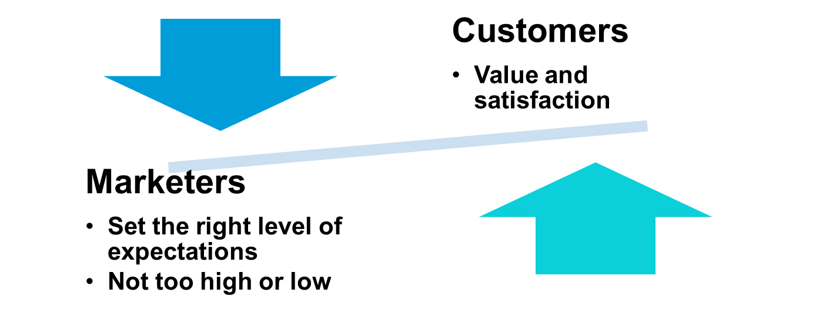
Understanding the Marketplace and Customer Needs
Customer Value and Satisfaction
Expectations

Slide 26
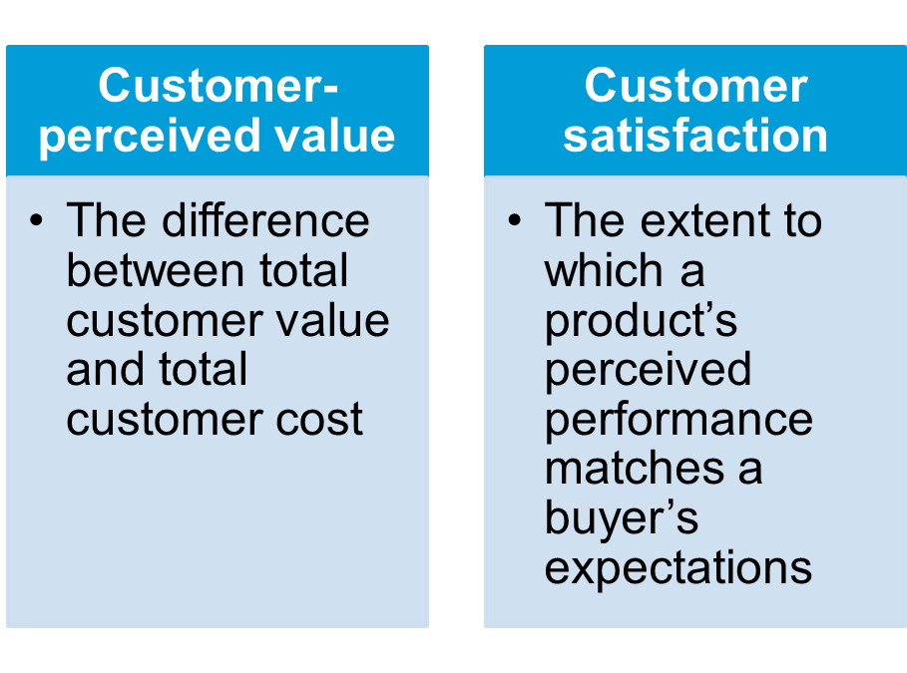
Building Customer Relationships
Relationship Building Blocks: Customer Value and Satisfaction

Slide 27



Value and Satisfaction
Expectation
Performance
Expectation
Performance
8
10
10
8
If performance is higher than expectations, satisfaction is high.
If performance is lower than expectations, satisfaction is low.
1-<number>

Slide 28
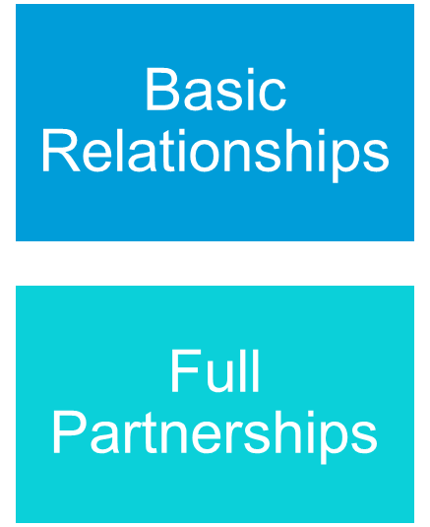
Building Customer Relationships
Customer Relationship Levels and Tools

Slide 29
Building Customer Relationships
The Changing Nature of Customer Relationships
Relating with more carefully selected customers uses selective relationship management to target fewer, more profitable customers
Relating more deeply and interactively by incorporating more interactive two way relationships through blogs, Websites, online communities and social networks

Slide 30
Building Customer Relationships
Partner Relationship Management
Partners inside the company is every function area interacting with customers
  Electronically
  Cross-functional teams
Partners outside the company is how marketers connect with their suppliers, channel partners, and competitors by developing partnerships

Slide 31
Capturing Value from Customers
Growing Share of Customer
Share of customer is the portion of the customer’s purchasing that a company gets in its product categories
Customer life time value: life time purchases

Slide 32
Capturing Value from Customers
Customer equity
is the total combined customer lifetime values of all of the company’s customers

Slide 33
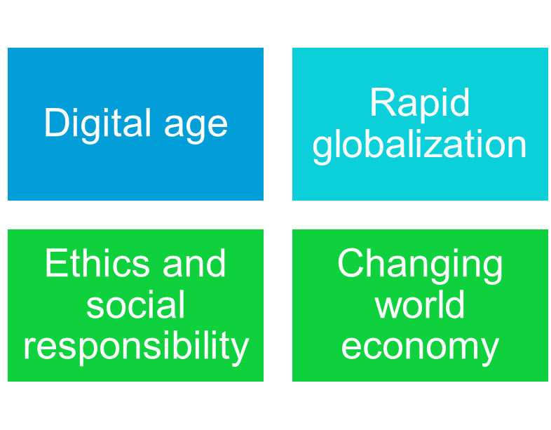
The Changing Marketing Landscape
Major Developments

Slide 34
Thank You

